Slide 1
ammonia emissions
Zhenqi Luo 2021.1
Notes:
https://doi.org/10.5194/acp-20-2277-2020

Slide 2
progress
1. Spatial distribution and timeseries of GEOS-Chem lifetime
2. Check the IASI emission fluxes based on GEOS-Chem lifetime

Slide 3
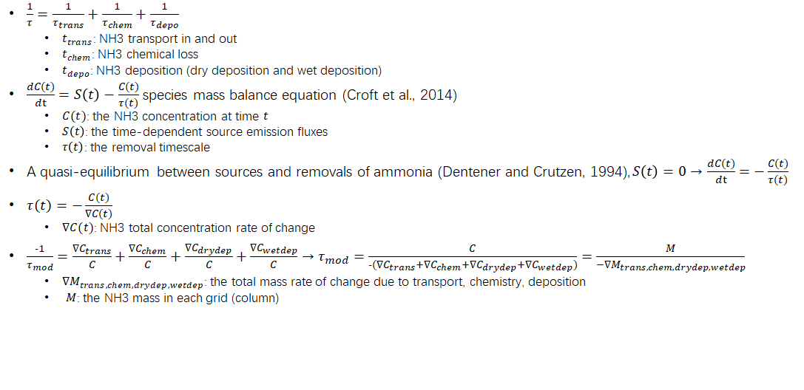
lifetime

Slide 4
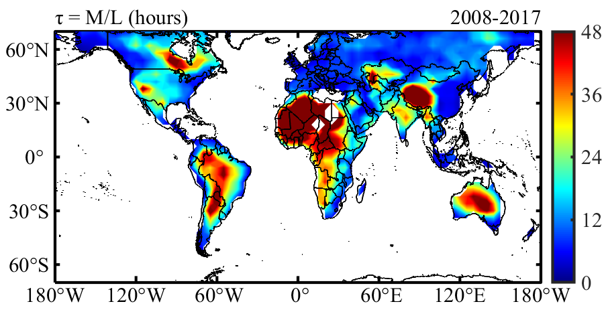
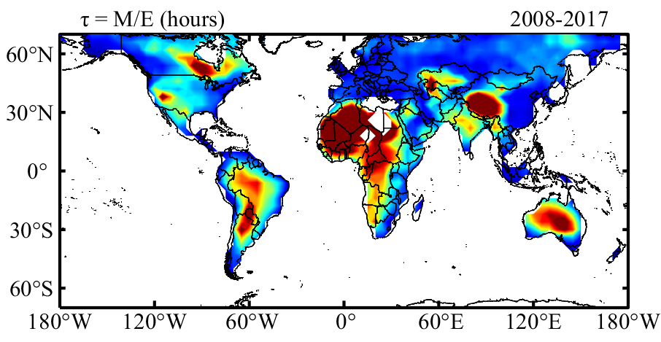
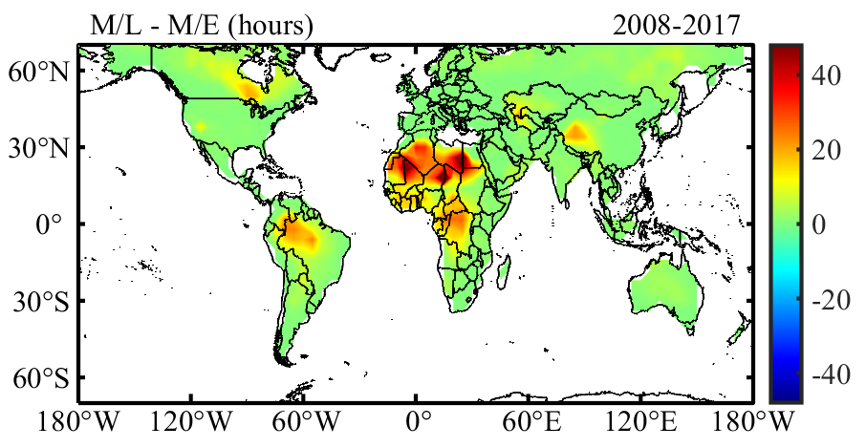
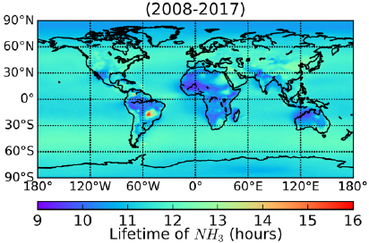
Average lifetime of NH3
(Evangeliou et al., 2020)

Slide 5
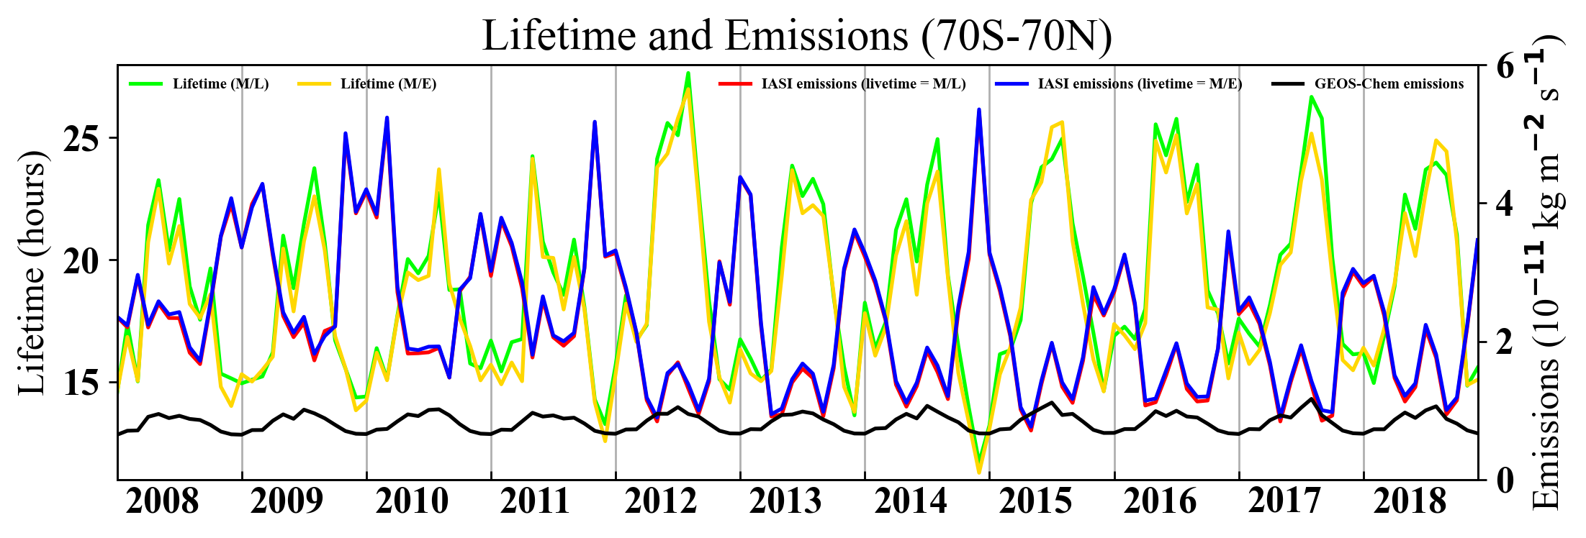
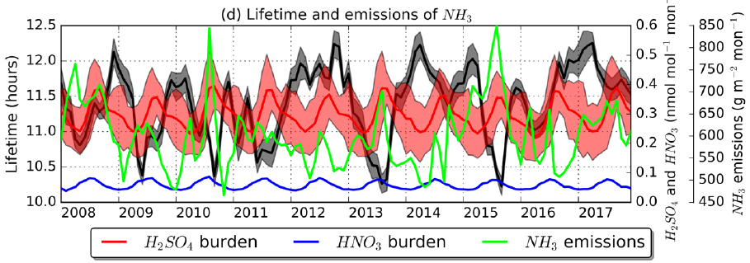
Monthly timeseries of lifetime and emissions
(Evangeliou et al., 2020)

Slide 6
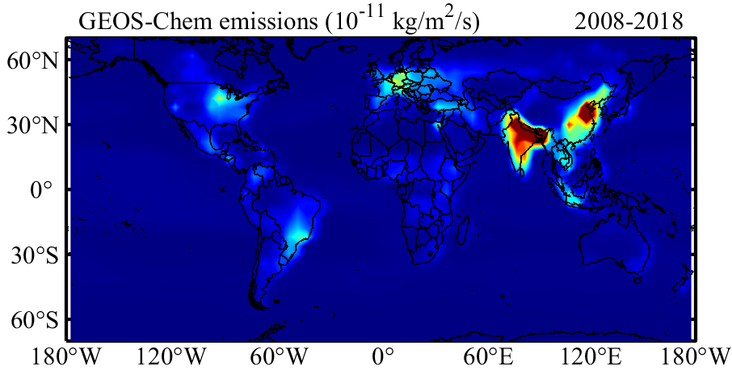
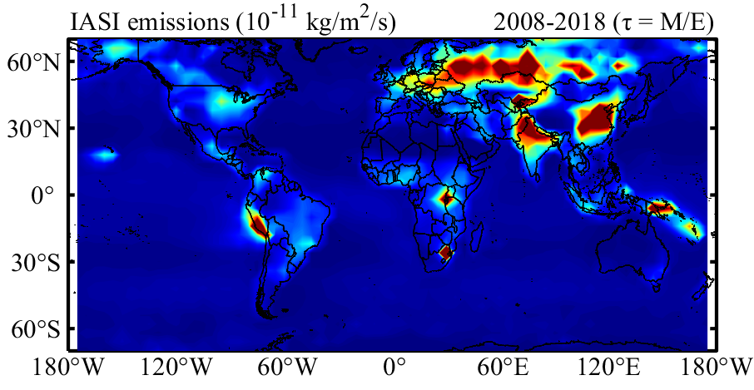
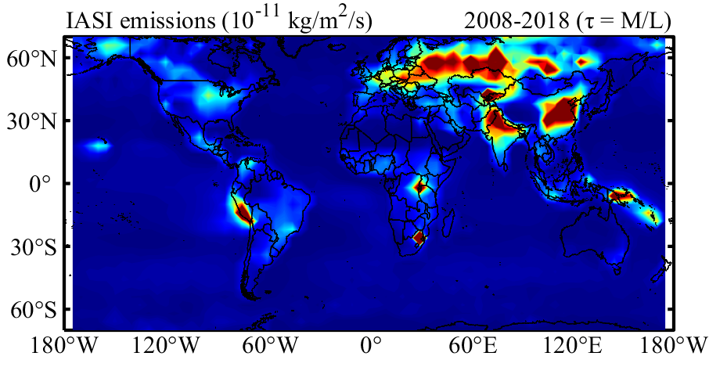
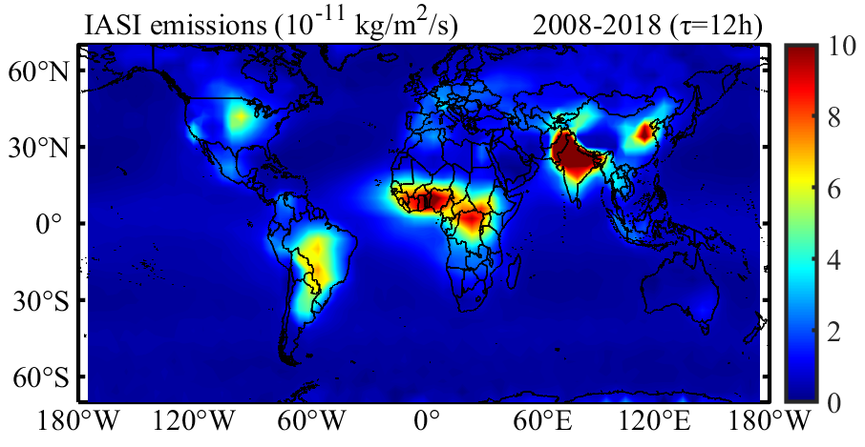
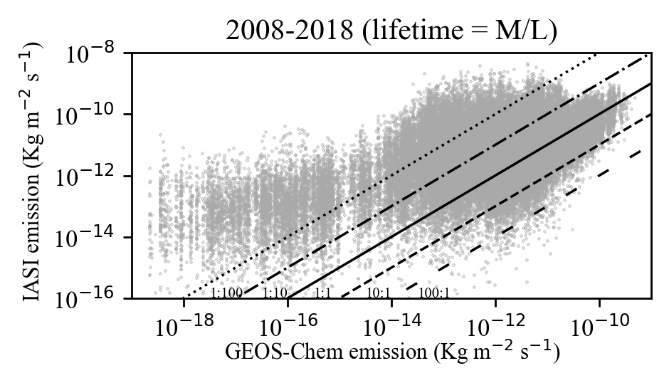
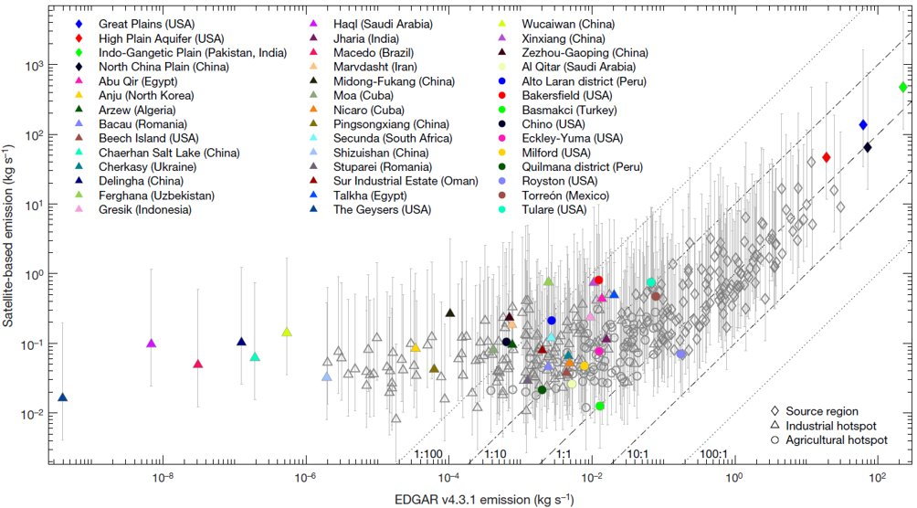
Problems encountered

Slide 7
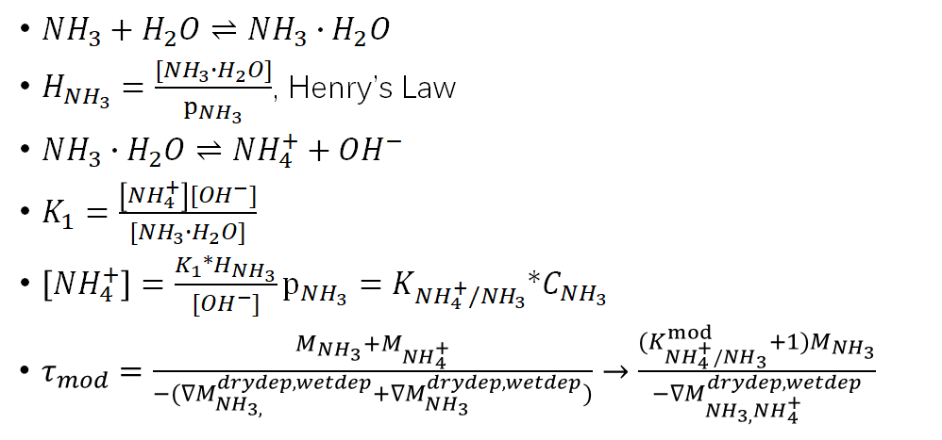
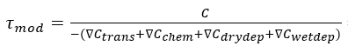
Analysis
GEOS-Chem lifetime
Neglect the transport——transportation from the adjacent grid-cells should be small (Evangeliou et al., 2020)
Consider ammonia-water equilibrium——chemical reaction between NH3 and NH4+ is reversible
IASI concentration filter: cloud coverage, skin temperature
not all periods of the year are sampled equally——the effect on the global distribution is modest (Damme et al., 2018)
skin temperature threshold (263.15K) impact the number of retrievals in high latitude area during winter

Slide 8
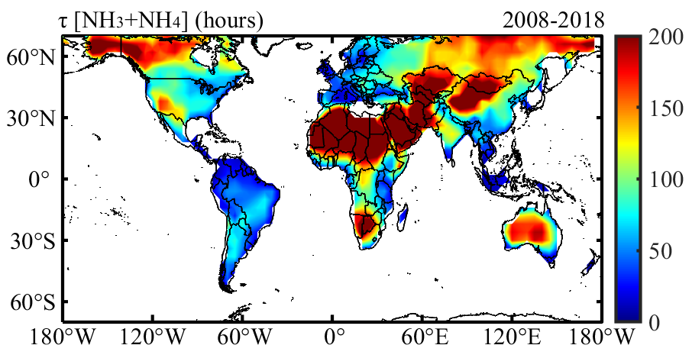
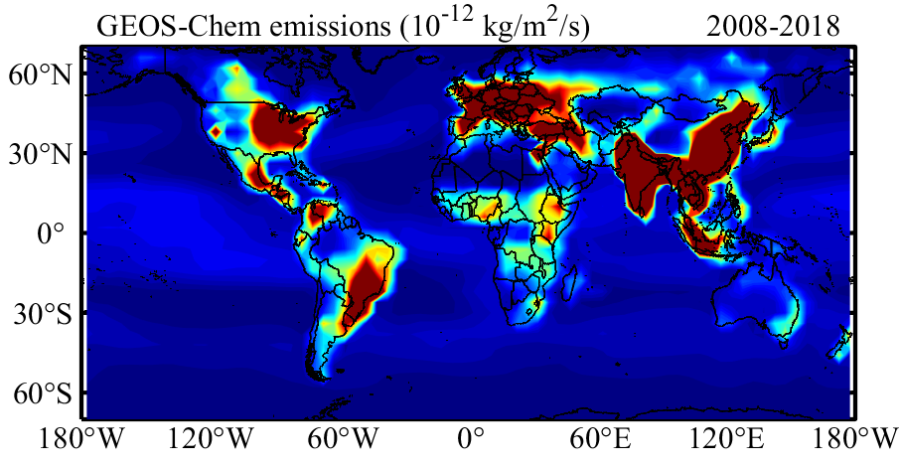
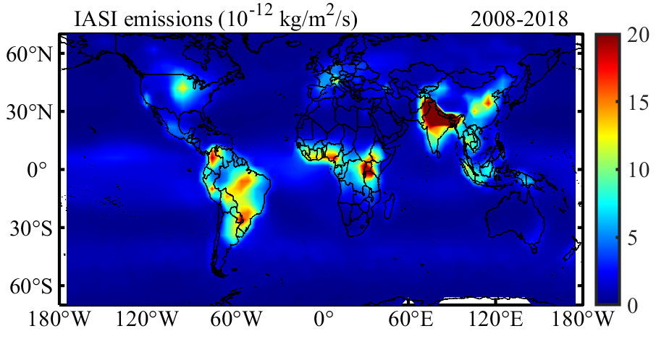
Consider ammonia-water equilibrium

Slide 9
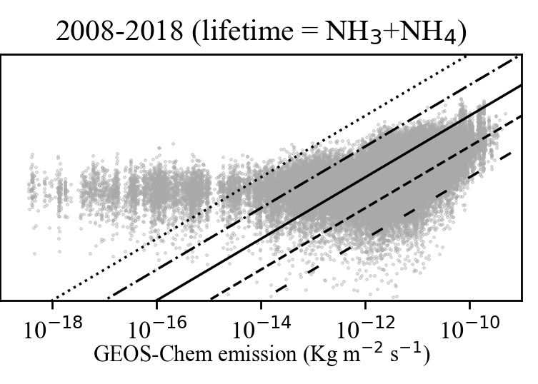
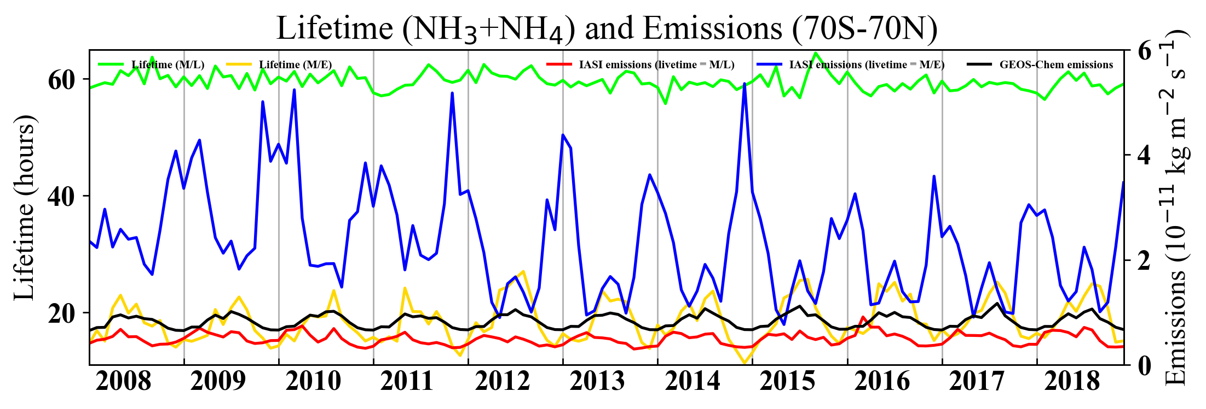
Consider ammonia-water equilibrium

Slide 10
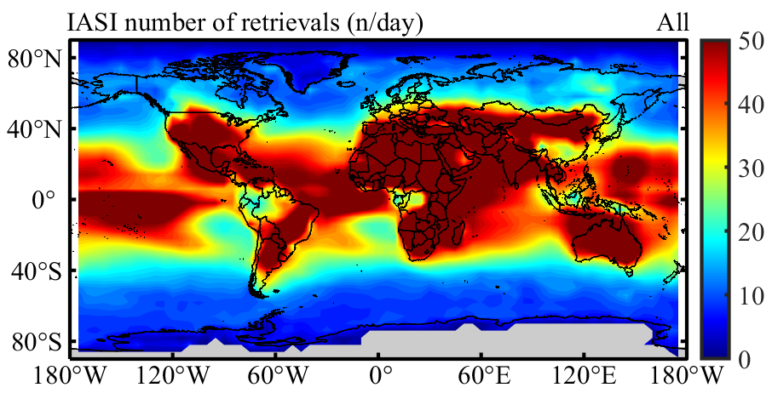
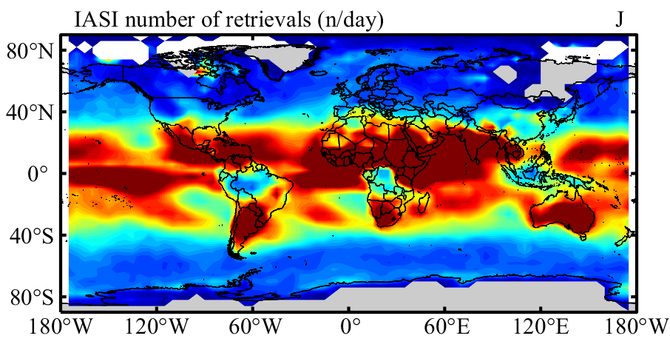
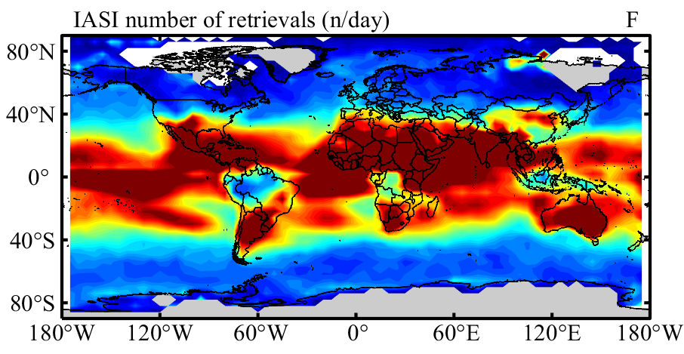
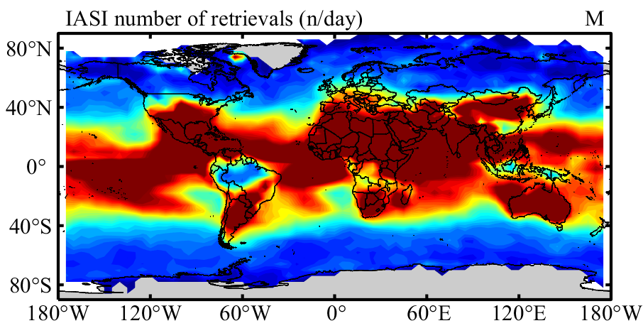
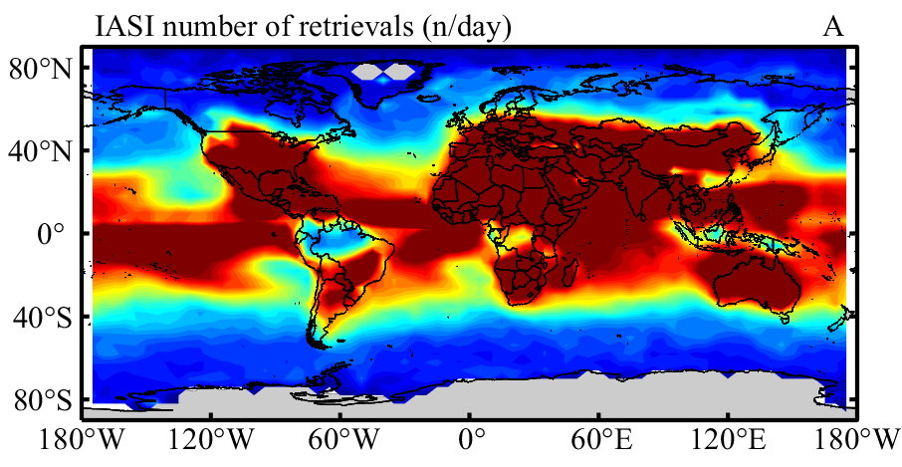
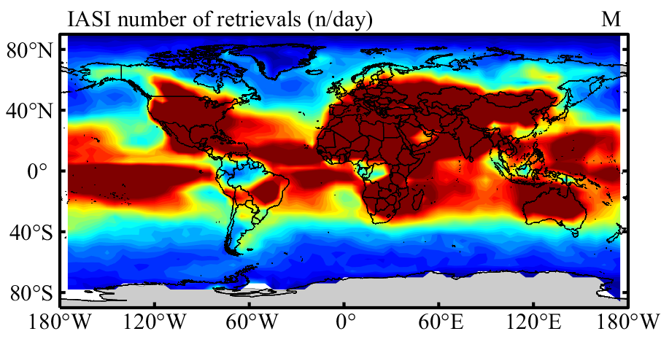
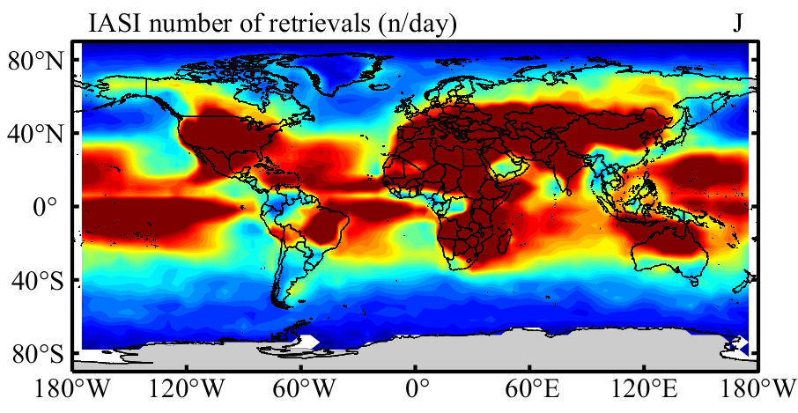
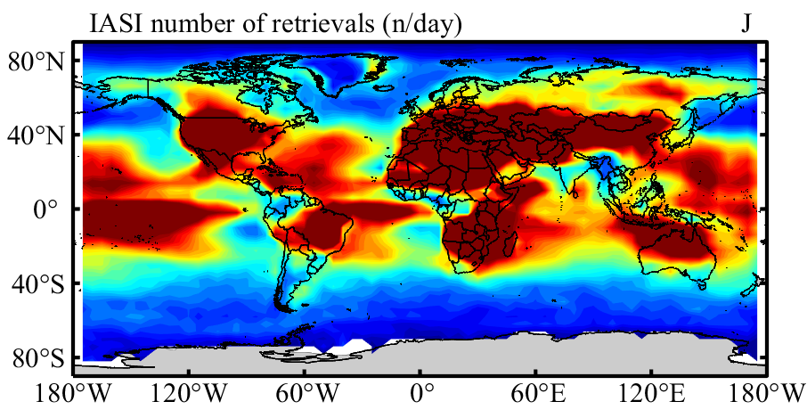
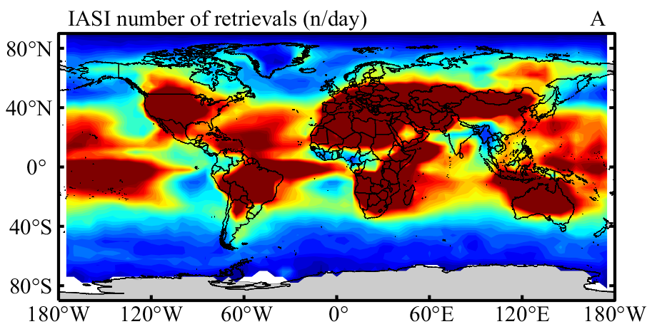
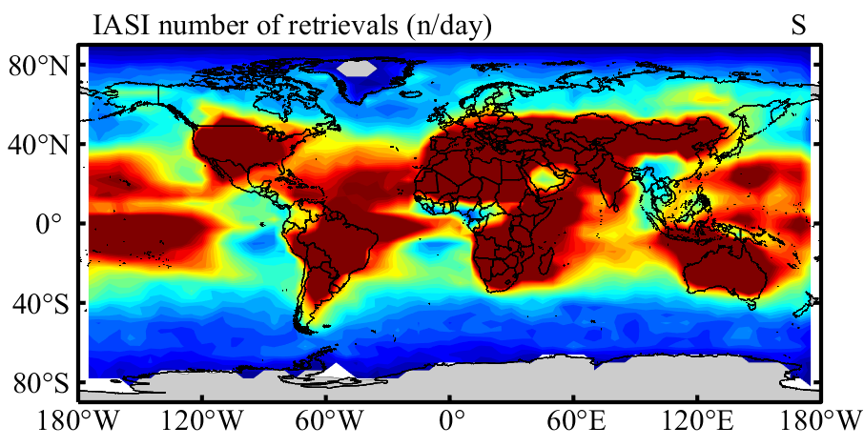
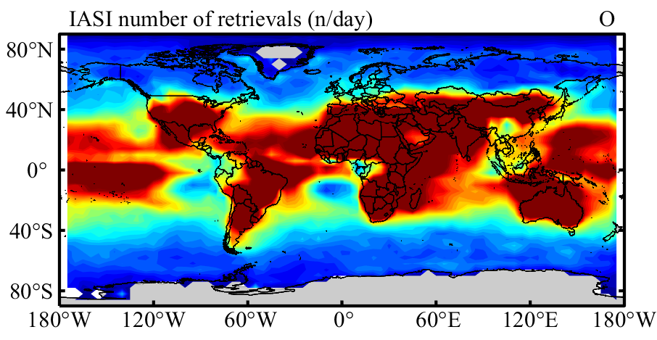
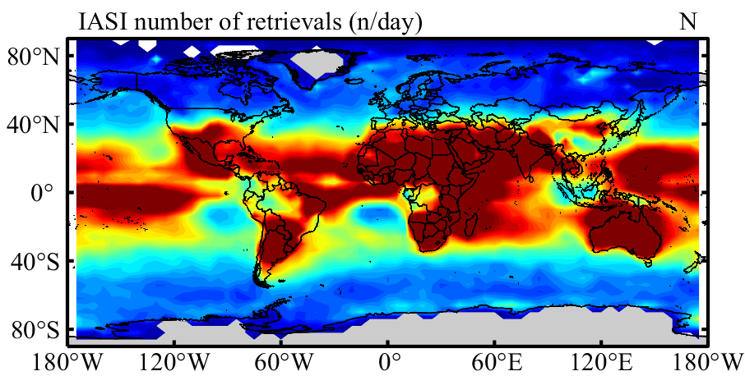
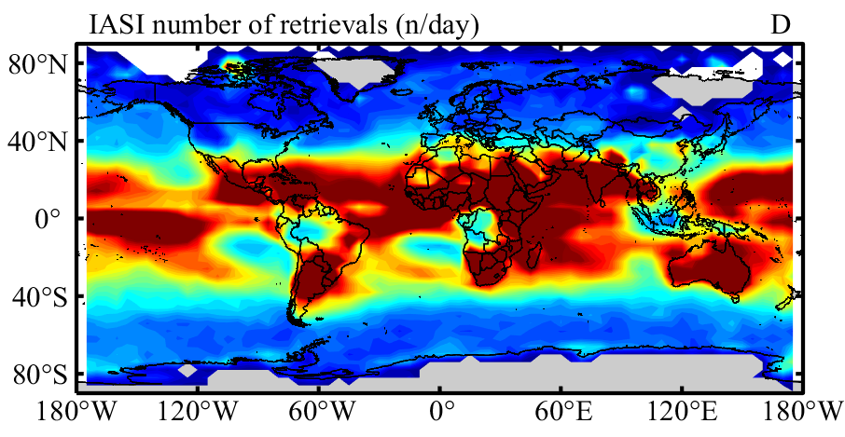
IASI mean in monthly number of retrievals

Slide 11
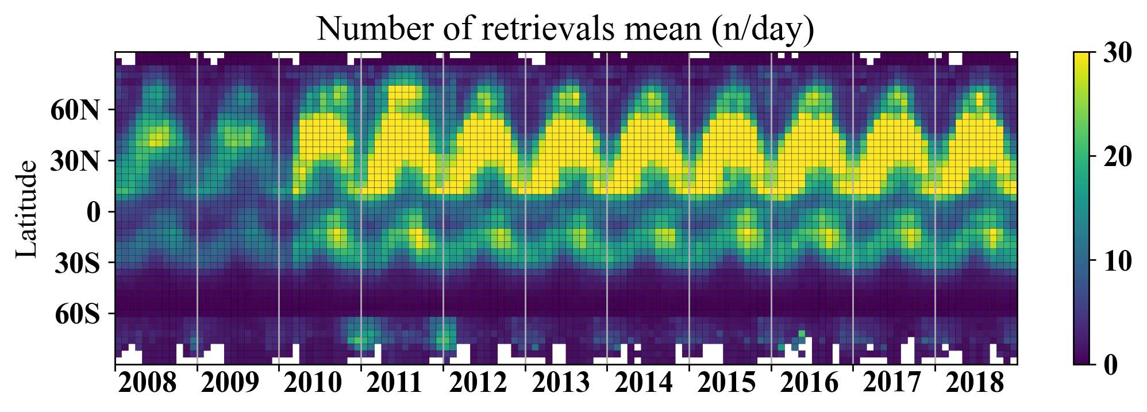
Data coverage binned by latitude of land, with one-month bin

Slide 12
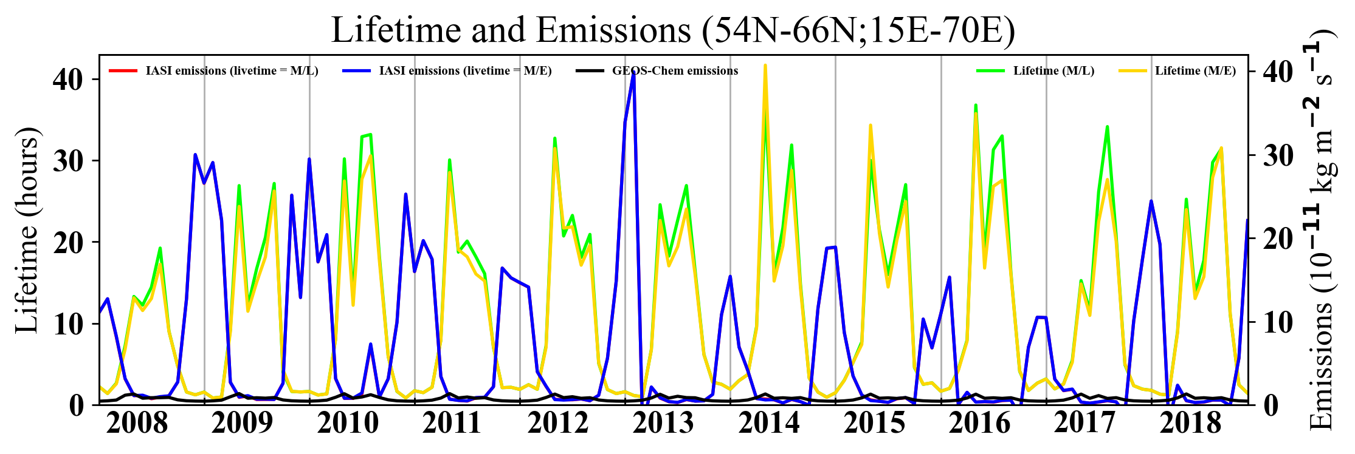
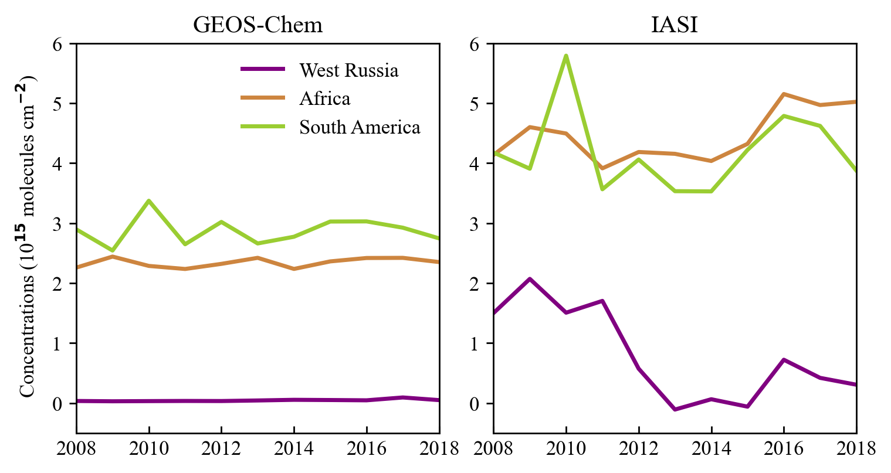
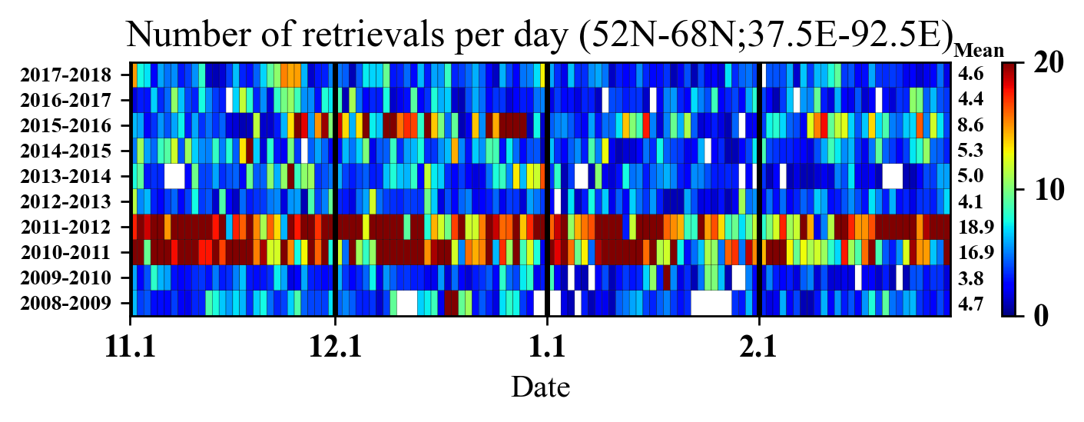
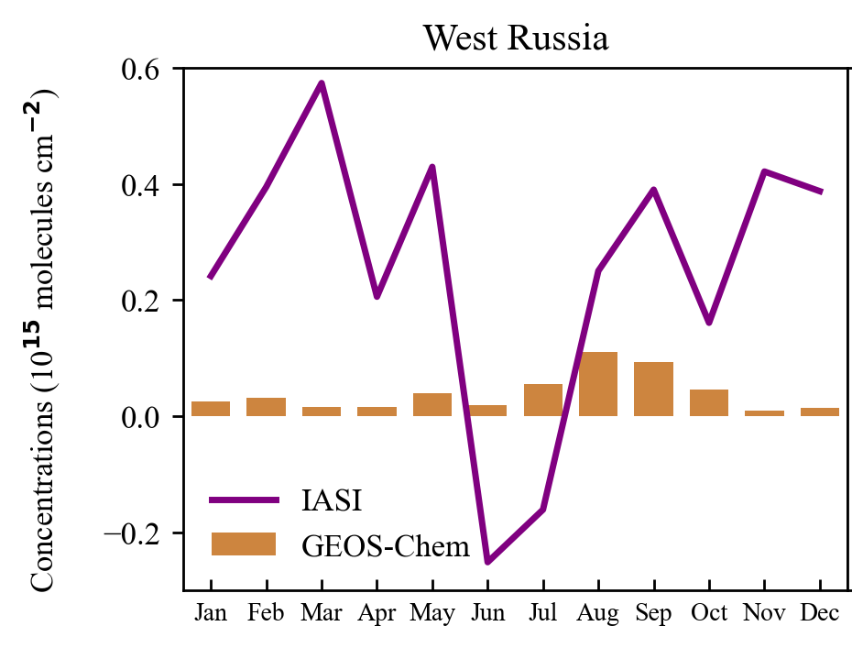
monthly timeseries of lifetime, emissions and concentration in WR Data coverage of winter in WR, with one-day bin

Slide 13
litreature

Slide 14
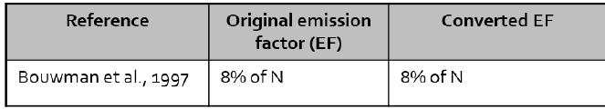
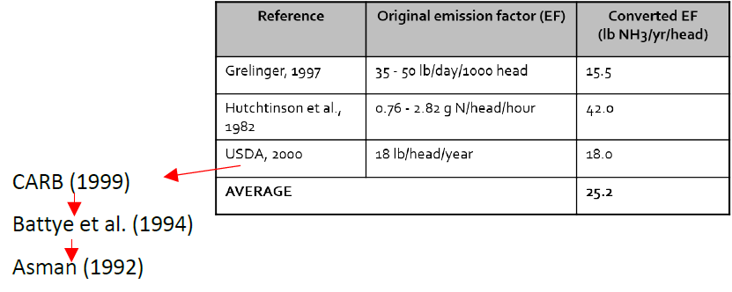
NH3 emitted from Concentrated animal feeding operations (CAFOs)
Current emission inventories (NEI v2011)
based on emissions factors derived from a small number of farms
beef feedlot
dairy
limited spatial resolution or site-specific information
Dependencies of ammonia emissions——housing and manure management practices
Temperature (strong)
Humidity
PH
Wind
Speed
Turbulence
Mobile laboratory Measurements——advantages
resolve local scale features not seen by satellites or flux inversions
validate process models
parametrize chemical transport model emission schemes
individually measure the majority of CAFOs in a region
(Golston et al., 2020)
Notes:
https://dx.doi.org/10.1021/acs.est.0c00301
e.g. whether manure is stored on-site or spread to nearby fields as fertilizer

Slide 15
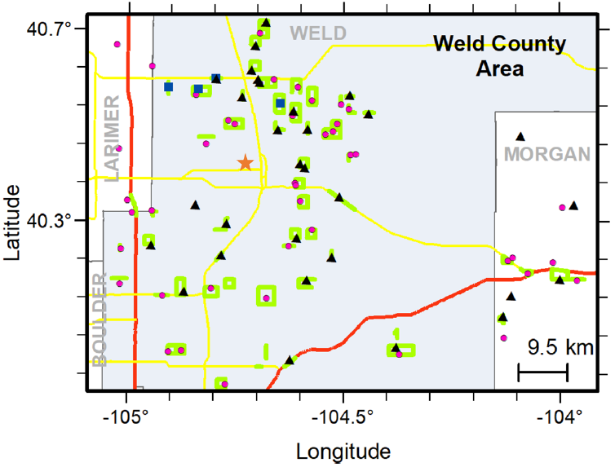
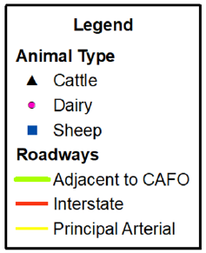
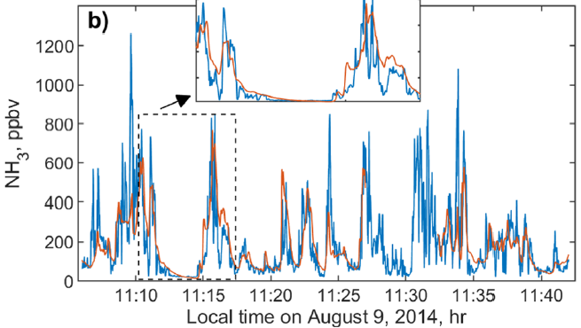
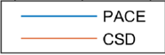
Experimental method——data
Instrumentation——calibrate and fit the correspondence
Princeton University Atmospheric Chemistry Experiment (PACE)
Aerodyne Mobile Laboratory (AML)
NOAA Chemical Sciences Division (CSD)
Sampling Campaign——encircling the farm
Driving routes: agricultural region surrounding the city
Diurnal Study: 5 sites
Intercomparison: PACE better resolved changes
Data Processing
Background——moving percentile
Concentration: 2%
Time window: 500s
Supplementary data——NOAA Rapid Refresh (RAP) assimilation and modeling system
COMET:
Surface downward shortwave radiation,
2 m air temperature (T)
friction velocity (u*)
sensible heat flux(H)
the u and v wind components at 10 m
NOMADS:
surface pressure
total cloud cover
(Golston et al., 2020)
Notes:
COMET. National Weather Service (NWS) Science and Operations Officer (SOO) Science and Training Resource Center (STRC): Rapid Refresh (RAP) 13km Domain http://soostrc.comet. Ucar.edu/data/grib/rap/
NOMADS. NOAA Operational Model Archive and Distribution System: RAP analysis https://nomads.ncdc.noaa.gov/data/rucanl/

Slide 16
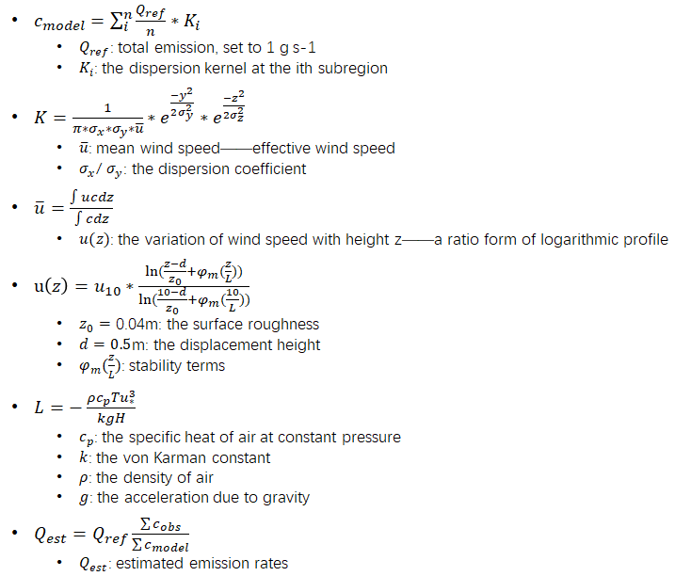
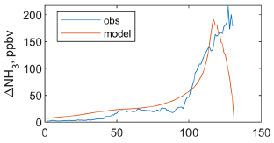
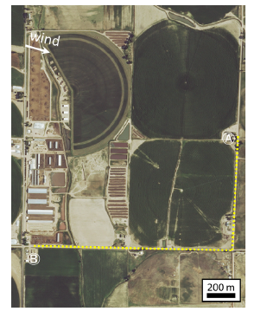
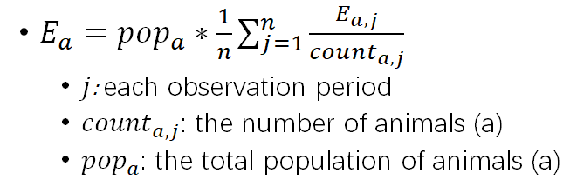
Experimental method——emissions estimation
an inverse area Gaussian plume
Modeled concentrations: discretize the area source region (50m spacing)
The total emissions in kg/month for animal type a
(Golston et al., 2020)
Notes:
Obukhov length: L

Slide 17
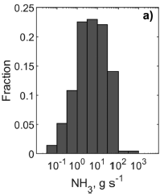
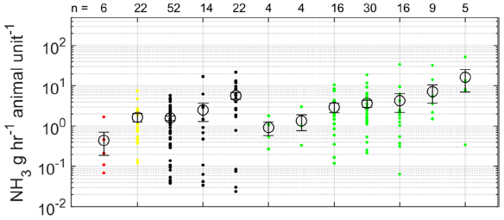


Results——ammonia emissions
Distribution
Mean: 15.9
Median: 5.1
Temporal Variability
25th percentiles: not follow a strong pattern
75th percentiles: distinctly seen during the afternoon
Temperature: increase
Site-to-Site and within-Farm Variability
Cattle
Dairy
Poultry
Sheep
Inventory
(Golston et al., 2020)
Notes:
cattle (black), dairy (green), poultry (red), and sheep (yellow)

Slide 18


NH3 emitted from Global Croplands
The food system——up to 90% of total NH3 volatilized
crop
livestock
Volatilization rates (VRs): assess the abatement potentials of NH3 emissions
uncertanty
the episodic nature of NH3 volatilization
the highly spatial variability of agricultural practices
approach
data-driven model: incorporate the environmental and practice related controls
process-based model: physicochemical processes of NH3 transfer across the cropland−atmosphere interface
Observations: peer-reviewed literature studies (1165 observations)
crop-specific VRs
climate
soil pH
fertilization schemes
experimental parameters
(Zhan et al., 2020)
Notes:
https://dx.doi.org/10.1021/acs.est.0c05149
from the land to the atmosphere

Slide 19


methods
Model
Mapping: year 2000
Crop specific harvested areas: EARTHSTAT dataset (5′ × 5′)
Mean daily air temperature: CRU TS V4.0334 climate dataset (0.5°×0.5°)
Mean daily wind speed: TerraClimate dataset (2.5′ × 2.5′)
Growing season: the period between the planting and harvesting dates (Sacks et al.)
A global gridded crop-specific fertilization scheme dataset
Acquire the total N application (15,790 units): local statistical agencies in 38 countries
Calculate the crop-specific N application rates: 21 specific crops
Allocate the proportion of 11 types of synthetic fertilizers: 113 provincial or state-level statistics
Determine the fraction of different placement methods in each grid cell: the fertilizer type and tillage practice
Abatement potential assessment: three scenarios
scenario 1: reduce the total N input [N use efficiency (NUE)] (Zhang et al.)
scenario 2: cap the proportion of two alkaline fertilizers (21.8% of total synthetic fertilizers)
scenario 3: S1 + S2
(Zhan et al., 2020)

Slide 20








results——2000 global cropland-NH3 VR
Emissions
globally averaged : 12.6 ± 2.1%
largest: cotton and rice
significantly different from one region to another
the top 10 emitting crops: 93%
paddy rice: 21%
wheat: 21%
maize: 15%
vegetables and fruits: 12%
Emission Intensities
highest: Pakistan, India, Iraq, the North China Plain, and those near the border between the United States of America and Mexico
dependent on cropping practices
dependent on location
Abatement Potentials
20% of harvested areas accounts for ∼63% of abatement potentials
S1: Asia
(Zhan et al., 2020)

Slide 21
plan
IASI emission
Lifetime calculation
Threshold for number of retrievals
Regional detail
trend
Notes:
:long_name = "The averaging kernel is the sensitivity of the estimated state to variations in the atmospheric state.
The averaging kernel matrix is stored in [col,row] notation. The rows of the averaging kernel represent the sensitivity of the estimated state at a specific pressure level to variations in the atmospheric state at all levels.
The columns of averaging kernel represent the sensitivity of the estimated state at all levels to variations in the atmospheric state at specific pressure level.
For atmospheric species this is the sensitivity of retrieved ln(vmr) to the true ln(vmr).";

Slide 22
Questions?

Slide 23




各省市常住人口学历，老龄化程度和收入水平
数据来源：《中国统计年鉴》（2019年）

